Slide 1
Reporting of critical potassium results reporting in hyperkalaemia: Audit and survey of practice in Scotland
Neil Greig
24/04/17

Slide 2
Standards
To review all potassium results greater than 6.5 mmol/L (defined as limit requiring urgent clinical action in the Royal College of Pathologists advice on out-of-hours reporting) for the month of September 2015 across responding Health Boards.
The guidance used to define the standards
That potassium results greater than 6.5 mmol/L should be communicated urgently, with the caveat that if the patient is known to the department and has a similar result within the previous seven days, result may not need urgent communication. (Royal College of Pathologists advice on Out-of-hours reporting of laboratory results).
That if results are not communicated, the reasons why they have not been reported are documented (Royal College of Pathologists, Key performance indicators, Proposals for Implementation)
That 97 % of critical results are communicated within 2 hours of the result being available (Royal College of Pathologists, Key Performance Indicators in Pathology).

Slide 3
Surveyed
Whether there are differences between timeliness of reporting between 9 to 5 pm weekday service and other times
Whether there were differences in reporting between different staff groups that may be involved
Whether laboratories comply with advice from Royal College of Pathologists directing that results phoned out-of-hours services should also be phoned to the GP patients surgery at the first opportunity within normal working hours. (Royal College of Pathologists advice on out-of-hours reporting of laboratory results).
What exclusion criteria laboratories apply to the reporting of potassium ie what time frame does the laboratory define as delayed separation, what are practices for reporting of haemolysed and EDTA-contaminated samples

Slide 4
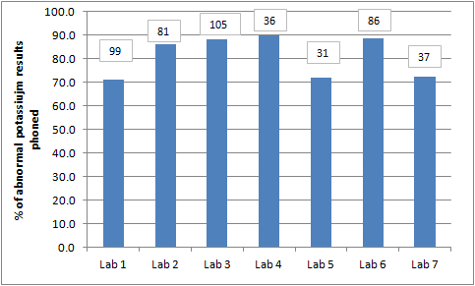
Question 1
What percentage of all potassium results greater than 6.5 mmol/L, irrespective of time potassium result was available, were telephoned to clinical users (with the caveat that if the patient is known to the department and has a similar result within the previous seven days, result may not need urgent communication)? How many actual potassium results does this equate to?

Slide 5
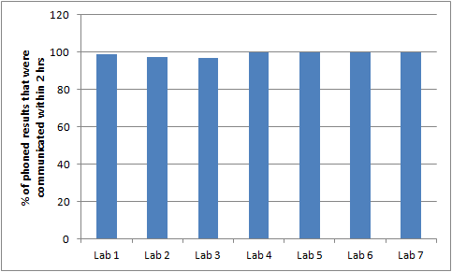
Question 2
Of all the potassium results telephoned, what percentage were telephoned within 2 hours of the result being available?

Slide 6
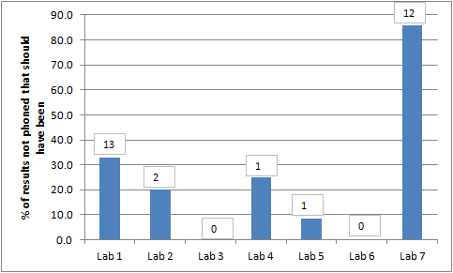
Question 3
Of the results not communicated, what percentage and number on review should have been phoned?

Slide 7
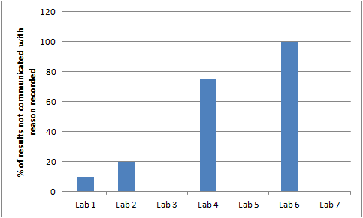
Question 4
Of the results not telephoned, what percentage had the reason why they were not communicated documented? Please state whether it is your departmental policy to document the reason for a critical result not being phoned.
Lab 2 has departmental policy to record reason for not phoning
Lab 4 has departmental policy to record but this is at bench level, not recorded on report
All other labs have no departmental policy to record

Slide 8
Question 5
Laboratory | Practice
Lab 1 | Clinical scientist/office staff Monday – Friday 9-5, 5-6 clinical scientist staff, weekend 9- 1 clinical scientist. All other times BMS
Lab 2 | BMS staff, rarely clinical scientist Monday to Friday 9-5 if further explanation/ discussion required
Lab 3 | site 1 BMS staff scientist medic input Monday – Friday 9-5, weekend 9-1 Site 2 – clinical scientist selects results to be phoned by clerical staff Monday to Friday 9-6:30 and sat 9 – 1. Other times BMS Site 3 – BMS Site 4 – BMS
Lab 4 | Clinical Scientist Monday to Friday 9-5, BMS all other times
Lab 5 | BMS majority of the time
Lab 6 | Clinical scientist/Medic Monday – Friday 9- 8 pm, and weekend/bank holiday 08:45 – 12:30. BMS all other times
Lab 7 | Clinical Scientists/Chemical pathologists – Monday to Friday 09:00 to 21:00 Saturday 09:00 to 13:00 BMS staff all other times
Notes:
Which staff groups at your health board telephone potassium results and if multiple staff groups, over which time periods are they involved in communicating results (eg Clinical Scientist 09:00 to 20:00, BMS 20:00 to 09:00)?

Slide 9
Question 6
If your Health board operates different reporting practices at multiple sites (eg site A has potassium results communicated by clinical scientist/medic between 09:00 and 17:00 and BMS outwith those hours and site B has potassium results communicated solely by BMS staff), what percentage of potassium results were reported within two hours at each site where practice varies?
Laboratory | Practice
Lab 1 | NA
Lab 2 | Standardised across 3 sites
Lab 3 | Site 1 – 97% Site 2 – 97 % Site 3 – 100 %
Lab 4 | NA
Lab 5 | Standardised procedures
Lab 6 | Standardised procedures
Lab 7 | Standardised procedures

Slide 10
Question 7
What percentage of telephoned potassium results available during standard GP surgery working hours (09:00 to 18:00) were communicated within two hours? What percentage of results available outwith these times were communicated within two hours?
Laboratory | % within 09:00 – 18:00 | % outwith 09:00 – 18:00
Lab 1 | 100 | NA
Lab 2 | 93.5 | 96
Lab 3 | 98.2 | 95.9
Lab 4 | 89 | NA (all reported by 18:00)
Lab 5 | 100 | 100
Lab 6 | 100 | 100
Lab 7 | 100 | 100

Slide 11
Question 8
Please state how your health board communicates critical results for Primary care patients once their GP surgery is closed. Are these results routinely phoned to the requesting location at the first opportunity the next working day?
Common themes – no lab policy to communicate records to GP next day!
Dedicated local out of hours service to communicate results to.
Results not phoned to GP Practice next day but out of hours report detailing clinical decision for patient generated.
Opportunity to provide feedback to out of hours advice issued by Royal College of Pathologists

Slide 12
Question 9
What are your protocols for acceptance/rejection of potassium results due to time delay/contamination? Please include SOPs and if available, evidence base.
Common themes for delayed samples
Laboratories reject samples greater than 24 hrs old for potassium analysis
Great variation in reporting procedures thereafter. No evidence base cited.
Many are using clinical/technical judgement to decide whether results should be reported between 12 and 24 hrs .
Common themes for contamination
Reflex on of calcium and ALP when unexpected potassium result obtained
Only two laboratories have protocols in place based on numerical values of potassium/calcium to aid technical/clinical validation decisions

Slide 13
Question 10
What are your protocols for acceptance/rejection of potassium results due to Haemolysis? Please include SOPs and if available, evidence base. Please state whether your laboratory uses automated serum indices for the assessment of haemolysis. If so, please state the manufacturer, instrument(s) and cut-offs used ie indice level equating to slightly haemolysed, haemolysed, grossly haemolysed etc. If your health board operates over multiple sites and processes are different at different sites (eg due to analytical equipment differences), please include information for all analytical platforms/sites.
Response from Abbot users is harmonised (two responses)
Response from Siemens users is harmonised (two users). Both Siemens users have protocol to report haemolysed potassium results when potassium is < 3.4 mmol/L.
All three Roche users have different cut-offs (57, 60 and 90 umol/L) despite all citing manufacturers guidance and using the same platform. Feedback will be provided RE opportunity to review evidence base and move to consensus

Slide 14
Conclusions
Laboratories who took part in the audit meet the standard that 97 % of potassium results > 6.5 mmol/L should be communicated within 2 hrs.
Two boards require review of results that they have not communicated.
Nearly all responding boards will need to change practice to meet KPI regarding logging reasons for a defined critical result not being communicated.
That other less skilled staff groups, such as BMS and clerical staff can be used to report results without impacting communication of results.
That communication of critical results is off a high standard across a 24/7 period.
There is no need to communicate results to a GP practice next day, provided there is a system in place for out-of-hours to communicate with GPs.
There is a need to define a national standard regarding acceptance/rejection criteria for delays in potassium reporting
The Roche usergroup needs to harmonise practice regarding haemolysis levels and potassium reporting.

