Slide 1
Audit of Acute Kidney Injury Stage 2 and Stage 3 alerts in Primary Care patients
Jane Oakey
Consultant Clinical Biochemist

Slide 2
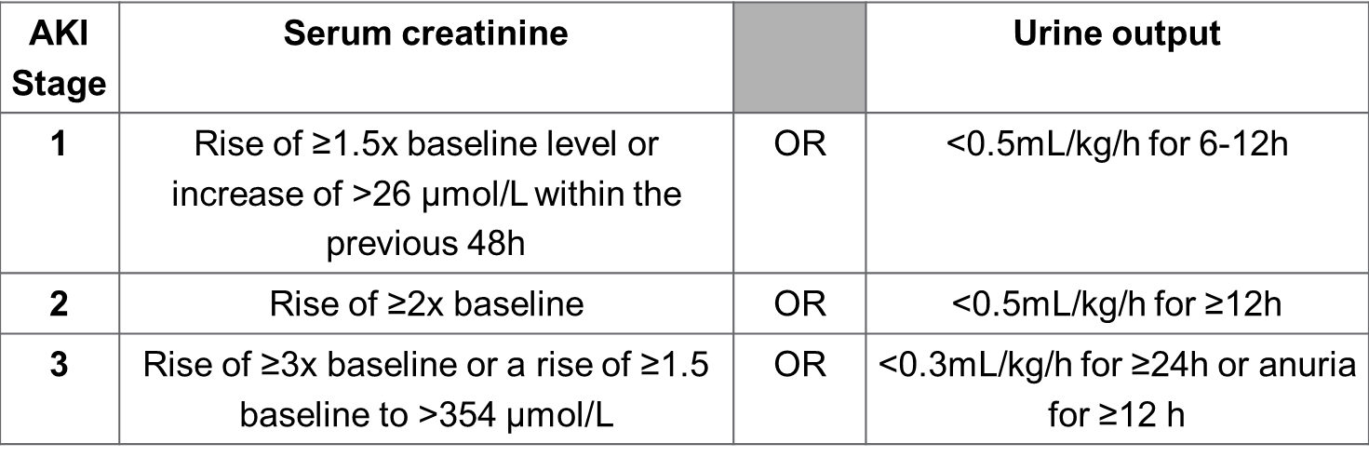
Acute Kidney Injury
NHS England Patient Safety Alert to implement AKI alerts in Secondary Care by March 2015 using the national algorithm
The algorithm compares the current creatinine result to a baseline creatinine (lowest creatinine in the last 7 days or the median creatinine over the previous 8-365 days)
Notes:
Early detection of AKI using Primary Care creatinine results is vital for improving outcomes
Think Kidneys provided guidance information and recommended response times for AKI alerts in Primary Care

Slide 3
AKI Alerts in Primary Care
Approximately 65% of AKI starts in the community
Alerting mechanisms also required for creatinine results from Primary Care patients
Recommended response times to AKI alerts for adults in Primary Care:
Alert | Stable clinical context | Context of acute illness
AKI Stage 1 | Consider clinical review ≤ 72 hours of alert to confirm/refute AKI | Consider clinical review ≤ 24 hours of alert. Likely AKI Stage 1
AKI Stage 2 | Consider clinical review ≤ 24 hours of alert to confirm/refute AKI | Consider clinical review ≤ 6 hours of alert. Likely AKI Stage 2
AKI Stage 3 | Consider clinical review ≤ 6 hours of alert. If AKI confirmed, consider admission | Consider immediate admission. Likely AKI Stage 3
www.thinkkidneys.nhs.uk/aki
Selby et al, PLoS One (2012)
Notes:
Recommended response times to AKI alerts for adults in Primary Care² Consider drugs that maybe harmful to kidneys, obstruction, hydration and infection. If there are AKI risk factors (e.g. poor oral intake/fluid output, hyperkalaemia, known CKD stages 4-5, past history of AKI, other comorbidities) consider earlier review.

Slide 4
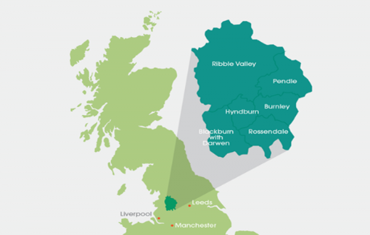
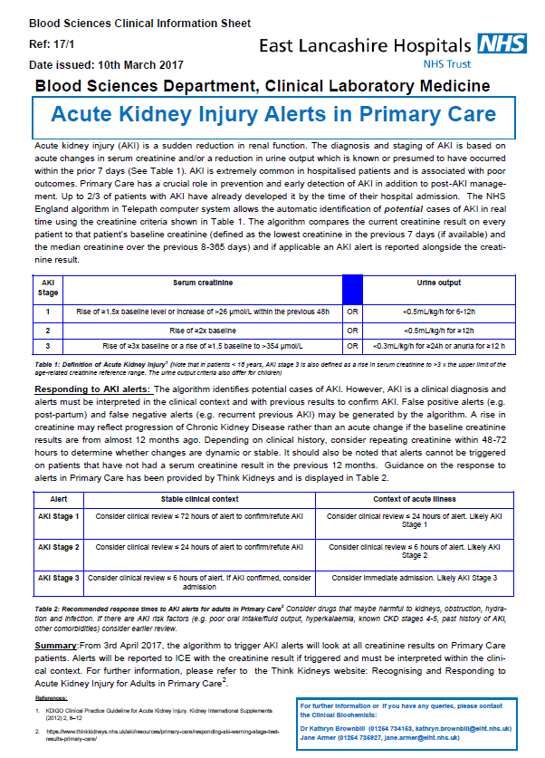
Introducing Primary Care AKI alerts in East Lancashire
GP educational sessions provided
AKI alerts reported with all Primary Care creatinine results from April 2017
Notes:
Two CCGs
Population: 530 000
82 GP practices
All Primary Care samples analysed at the Blackburn laboratory
1100 renal profile requests received every weekday from Primary Care

Slide 5
Audit Aim and Standards
Aim: To determine the follow up and patient outcomes following an AKI Stage 2 or 3 alert within Primary Care in East Lancashire
 | Standard | Source
1 | New occurrences of AKI 2 and 3 alerts should be telephoned | RCPath The communication of critical and unexpected pathology results (2017)
2 | Patients with AKI 2 or 3 alerts should be reviewed within 24 hours or 6 hours respectively (earlier if patient is acutely unwell). | Think Kidneys
Notes:
There is currently limited information on the response to an AKI alert or outcomes for Primary Care patients

Slide 6
Audit Methodology
All Primary Care AKI 2 and 3 alerts from 1st January – 30th April 2018 were extracted from the LIMS
Each patient’s record was reviewed:
Was the result telephoned?
What action was taken following the phone call?
What was the mortality rate at 30 days?

Slide 7
Primary Care AKI alerts (Jan-April 2018)
Alert | n | Percentage of total | No. of patients | Male % (n) | Median age (range)
AKI 1 | 377 | 0.43 | 370
AKI 2 | 56 | 0.06 | 48 | 46% (22) | 77 (35-97)
AKI 3 | 37 | 0.04 | 34 | 56% (19) | 70 (20-88)
Notes:
Total number of Primary Care AKI alerts = 87247

Slide 8
Standard 1: AKI 2 and 3 alerts should be telephoned to Primary Care
 | AKI 2 | AKI 3
No. of alerts | 60 | 37
Telephoned to the GP practice or Out of Hours Service (n (%) | 59 (98%) | 33 (89%)

Slide 9
Follow up- AKI Stage 2

Slide 10
Standard 2: Patients with AKI 2 alerts should be reviewed within 24 hours
n=48 patients
Notes:
58% of patients were admitted to hospital immediately
Median time to hospital admission was 9 hours

Slide 11
Follow up of patients with AKI 2 alerts
Patients admitted to hospital (30/48)
Median time from phone call to admission = 9 hours
4 patients progressed to an AKI 3 alert on admission sample
Repeat blood samples collected at GP surgery (7/48)
3 patients admitted the next day (1 progressed to AKI 3 alert on the repeat blood sample)
No admission/repeat sample (8/48)
None were subsequently admitted with AKI (up to 31.08.18)
No further action required (3/48)
1 post pregnancy
2 patients were known Chronic Kidney Disease patients
Notes:
1 patient had AKI3 on the repeat sample
CKD patient – the alert did not suggest AKI based on previous results and history

Slide 12
Follow up- AKI Stage 3

Slide 13
Standard 2: Patients with AKI 3 alerts should be reviewed within 6 hours
n=34 patients
Notes:
62% of patients were admitted to hospital immediately
Median time to hospital admission was 7 hours

Slide 14
Follow up of patients with AKI 3 alerts
Patients admitted to hospital (21/34)
Median time from phone call to admission = 7 hours
No admission/repeat sample (3/34)
None were subsequently admitted with AKI (up to 31.08.18)
No further action required (10/34)
9 patients were known Chronic Kidney Disease patients
1 patient was receiving palliative care
Notes:
No admission/repeat sample: 1 patient had a repeat blood sample collected 17 days later
2 patients attended the Hepatology Clinic approximately 2 weeks later
CKD – the alert did not suggest AKI based on history and previous results
Hepatology Clinic patients - Repeat renal results confirmed that the renal function had improved and the creatinine was similar to previous baseline results.

Slide 15
30 day mortality rate in Primary Care patients with AKI alerts
Notes:
Wales study looking at Primary Care has reported a 90 day mortality rate of 15.4% for all stages of alert.
The renal registry data is adjusted for age and sex

Slide 16
Primary Care AKI Alerts- Summary
95% of AKI 2 and 3 alerts were telephoned by the laboratory to Primary Care
Most patients were admitted to hospital within 24 hours of the alert phone call (58% and 62% for AKI 2 and 3 respectively)
Five patients progressed from AKI Stage 2 to AKI Stage 3 (four patients had already been admitted)
Thirteen patients had alerts but did not have AKI
Eleven patients were not admitted and had no repeat blood sample; none were subsequently admitted to hospital with AKI (to date)
The mortality rates in Primary Care patients with AKI alerts (6% and 15% for AKI 2 and 3) were lower than the nationally reported mortality rates from the Renal Registry (25.4% and 27.3% for AKI 2 and 3)

Slide 17
Conclusions
Guidance and educational sessions for Primary Care is essential for the successful implementation of AKI alerts
Phoning all AKI 2 and 3 alerts to Primary Care is ensuring rapid review and admission to hospital of the most appropriate patients
In our population, detection of AKI in Primary Care reduced the mortality rate (particularly for patients with AKI Stage 2)
Wider audit of outcomes following AKI alerting in Primary Care is required.
Review of guidance including targets for clinical review
Notes:
Think Kidneys Guidance has been useful for our population - Are the clinical review targets realistic or required?

Slide 18
Questions

