Slide 1


Phaeochromocytoma:
Proposed National Audit on Laboratory Investigation of Phaeochromocytoma/Paraganglioma
Chris Boot
Newcastle upon Tyne Hospitals NHS Foundation Trust

Slide 2
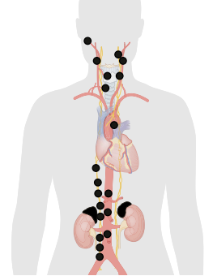
Phaeochromocytoma/Paraganglioma (PPGL)
Phaeochromocytoma
  Tumour arising from chromaffin cells of the adrenal medulla
Paraganglioma
  Tumour arising from extra-adrenal chromaffin cells of sympathetic or parasympathetic nervous system
Phaeo and sympathetic PGL secrete excessive amounts of catecholamines
  Hypertension, anxiety, sweating, tremor, catecholaminergic crisis
Genetic susceptibility syndrome in ~40% (or more?)

Slide 3
Catecholamine synthetic/metabolic pathways
Phenylethanolamine N-methyltransferase
Tyrosine hydroxylase
DOPA decarboxylase
Dopamine β-hydroxylase
Tyrosine
DOPA
Dopamine
Norepinepherine
Epinepherine
CATECHOLAMINES
Catechol-O-methyltransferase
MAO/COMT/ADH
3-methoxytyramine
Normetanephrine
Metanephrine
METANEPHRINES
Homovanillic acid (HVA)
Vanillylmandelic acid (VMA)
MAO/ADH
SULPHATION + EXCRETION
EXCRETION

Slide 4
Laboratory Investigation of PPGL
Screening/Diagnostic Tests
  Plasma/urine catecholamines
  Plasma/urine metanephrines
  Urine VMA
  Chromogranin A (??)
Genetic Testing
  ~40 % cases associated with genetic susceptibility

Slide 5
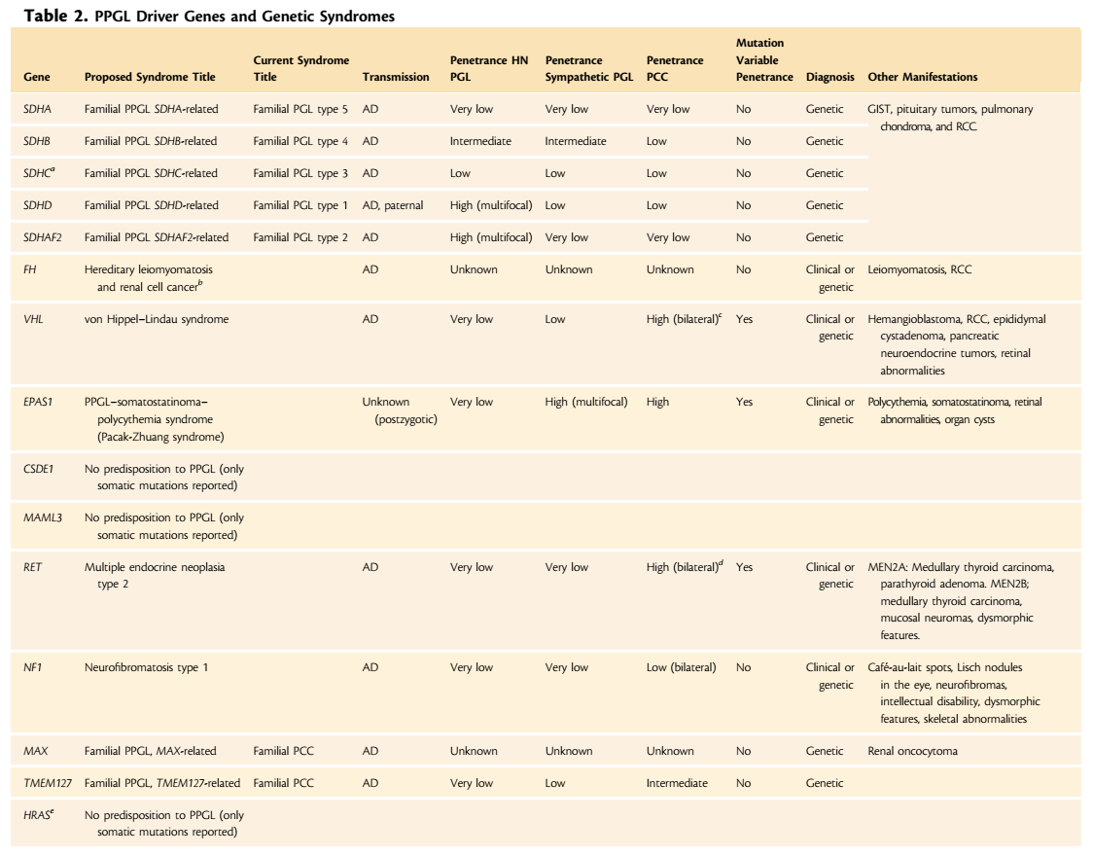
From:
Crona, Taieb, Pacak. Endocrine Reviews 2017:38;489-515

Slide 6
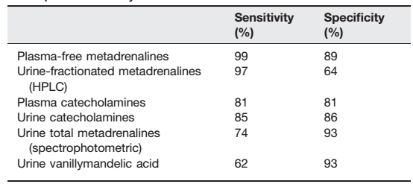
Which biochemical screening test?
High diagnostic sensitivity is vital (i.e. high NPV)
High diagnostic specificity also important (minimise FPs)

Slide 7
Why do we need a national audit?
Variations in practice
  First-line testing
  Protocols for second-line testing/follow-up
  Variations in methodology used
  Variations in reference ranges (e.g. seated vs supine for PMETs)
  Genetic testing
    Is testing offered to all patients diagnosed with PPGL?
    Which genes are tested?

Slide 8

Endocrine Society Guideline
Published 2014

Slide 9
Draft Standards: Based on Endo Soc Guidelines
Biochemical Investigation
  “We recommend that initial biochemical testing for PPGLs should include measurements of plasma free metanephrines or urinary fractionated metanephrines”
  “We suggest using liquid chromatography with mass spectrometric or electrochemical detection methods rather than other laboratory methods to establish a biochemical diagnosis of PPGL”
  “For measurements of plasma metanephrines, we suggest drawing blood with the patient in the supine position and use of reference intervals established in the same position”
  “We recommend that all patients with positive test results should receive appropriate follow-up according to the extent of increased values and clinical presentation”

Slide 10
Draft Standards: Based on Endo Soc Guidelines
Genetic Testing
  “We recommend that all patients with PPGLs should be engaged in shared decision making for genetic testing”
  “We recommend the use of a clinical feature-driven diagnostic algorithm to establish the priorities for specific genetic testing in PPGL patients with suspected germline mutations”
  “We suggest that patients with paraganglioma undergo testing of SDH mutations and that patients with metastatic disease undergo testing for SDHB mutations”
  “We recommend that genetic testing for PPGL be delivered within the framework of health care. Specifically, pre-test and post-test counselling should be available. All tests for PPGL genetic testing should be performed by accredited laboratories”

Slide 11
Draft Questionnaire
PROPOSAL FOR NATIONAL AUDIT OF THE LABORATORY INVESTIGATION OF PHAEOCHROMOCYTOMA AND PARAGANGLIOMA
Chris Boot and Barry Toole, Newcastle upon Tyne Hospitals NHS Foundation Trust
Sharman Harris and Lisa Tetlow, Betsi Cadwaladr University Health Board

Slide 12
Questions on:
Which biochemical tests used in biochemical screening (methodology)
  Firstline, ?any second-line only
  ?Role for CgA, clonidine suppression test
Specific questions for labs using plasma metanephrines
  Seated/supine reference ranges
  Posture(s) used in each centre (?different for different situations)
Genetic testing
  ?Offered to all new cases
  Panel of genes tested (?step-wise approach)

Slide 13
Aims/Possible Outcomes
Find out if UK centres practice in-line with Endo Soc guideline
  Identify variations in biochemistry tests used, how they are utilised
  Identify any variations in genetic testing offered
Publish findings: will be of interest to Lab Medicine and Endocrinology
  Possibility of producing specific recommendations for UK laboratories/endocrinologists
  ?Collaborate with UK Society for Endocrinology Adrenal/CV Network

