Slide 1
National Audit of the Laboratory Investigation of Adult Hyponatraemia
Presented on behalf of the Association for Clinical Biochemistry and Laboratory Medicine
by
Peter West
Honorary Consultant Biochemist
North Middlesex University Hospital NHS Trust, London
National Audit Meeting, Birmingham 8th September 2017

Slide 11
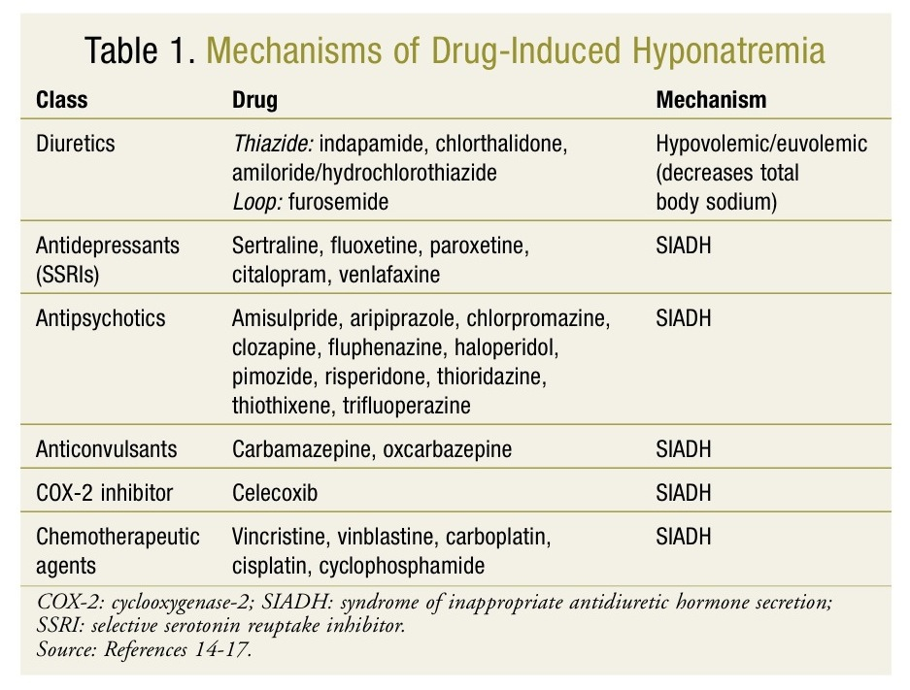

Slide 13
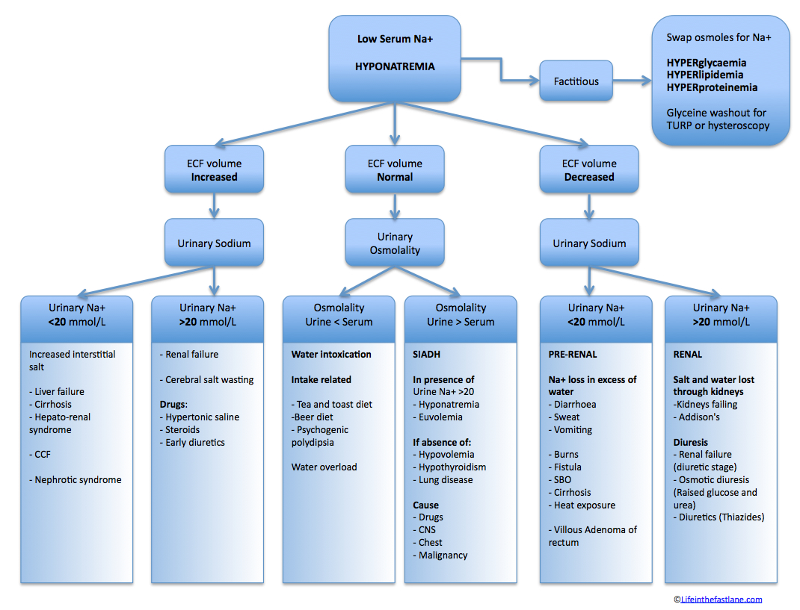

Slide 14
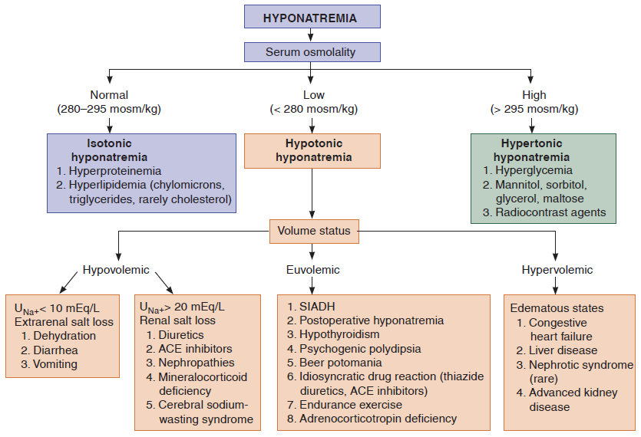

Slide 15
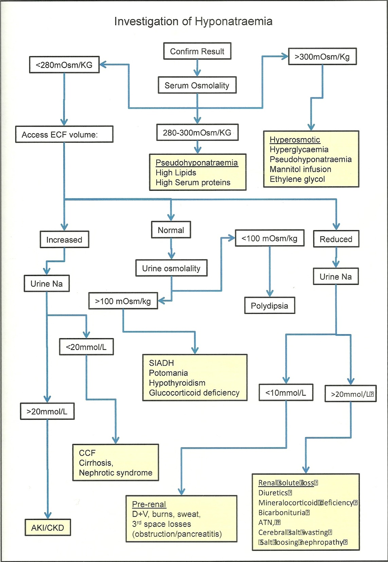

Slide 17
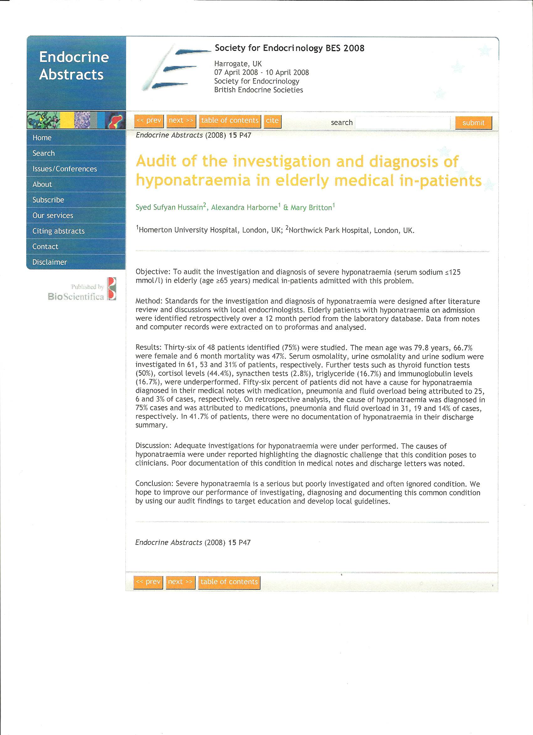

Slide 18
Question 1a-The details of the respondents to the survey monkey-a total of 51 respondents

Slide 19
Question 1b- The Trust location of those who responded to the survey monkey

Slide 20
Question 2-This shows the different types of Trust

Slide 21
Question 3-The reference range quoted by the laboratories for serum or plasma sodium

Slide 22
Question 4a-Whether the laboratories had a definition of hyponatraemia

Slide 23
Question 4b-How the laboratories defined hyponatraemia

Slide 24
Question 5a-The total number of individual patients aged 18 years or above admitted
to the hospitals between 1st January and 31st March 2017 with a reference serum or
plasma sodium between different levels of sodium with the reference sodium being
the first of that episode, whether direct from the ward or Accident and Emergency prior to admission(but not from the GP)

Slide 25
Question 5b-The average number of individual patients aged 18 years or above admitted
to the hospitals between 1st January and 31st March 2017 with a reference serum or
plasma sodium between different levels of sodium with the reference sodium being
the first of that episode, whether direct from the ward or Accident and Emergency prior to admission(but not from the GP)

Slide 26
Question 5c-The range of values for the different levels of the reference serum or plasma sodium
Different levels of plasma or serum sodium | Number within the sodium range
135 mmol/l or more | 3867-147800
125 mmol/l or more but less than 135 mmol/l | 13-16692
120 mmol/l or more but less than 125 mmol/l | 1-583
Less than 120 mmol/l | 1-303

Slide 27
Question 6a-The total number of individuals within the different aged groups who had a
reference sodium less than 135 mmol/l

Slide 28
Question 6b-The average number of individuals within the different age groups who had a
reference sodium less than 135 mmol/l

Slide 29
Question 6c-The number of individuals within the different age groups who had a
reference sodium less than 135 mmol/l
Age range | Number within the range
Between 18 and 50 years | 63-45739
Between 51 and 75 years | 383-79484
Over 75 years | 595-40155

Slide 30
Question 7-The percentage of males and females who had a reference sodium
less than 135 mmol/l
Sex | Average percentage | Range of percentages
Males | 46.6 | 42-50
Females | 53.4 | 50-58
In all but one case, the percentage of females was higher than males and in the one
case it was equal between males and females.

Slide 31
Question 8-The source of the requests as a percentage of the total
Laboratory | 1 | 2 | 3 | 4 | 5 | 6 | 7 | 8 | 9 | 10
Accident and Emergency | 13.4 | 29.7 | 27 | 77 | 52 | 3.5 | 17 | 68 | 43.8 | 7.8
General Medicine | 15 | 9.4 |  |  | 20 | 5 | 13 | 25 | 0.5 | 4.7
General Surgery | 9.9 | 13 |  |  | 1 |  | 14 | 7 | 11 | 2.8
Respiratory Medicine | 2.1 | 3 |  |  | 1 |  | 4 |  | 0.9 | 1.2
Care of the Elderly | 5.1 | 2.7 |  |  | 1 |  | 13 |  | 3.8 | 5.3
Orthopaedics | 3.8 | 6.2 |  |  | 1 | 3 | 0.05 |  | 2.3 | 5.1
Thoracic Medicine |  |  |  |  | 1 |  |  |  | 1.1
Critical Care | 4.7 | 6.8 | 2.0 |  | 3 |  | 2 |  | 4.9 | 9.3
Cardiology | 15.3 | 4.2 |  |  | 1 |  | 3.2 |  | 3.7 | 10.8
Renal | 1.2 | 9.0 |  |  | 3 | 1 | 0.22 |  | 3.9 | 25
Neurology | 2.7 |  |  |  | 1 |  | 0.03 |  | 2.1 | 0.63
Haematology | 3.6 | 0.1 |  |  | 1 | 1 | 0.41 |  | 1.2 | 0.41
Oncology | 2.0 | 2.1 |  |  | 2 | 0.6 | 1.12 |  | 7.3 | 25.4
Gastroenterology | 4.3 | 1.6 |  |  | 1 |  | 3.7 |  | 3.4 | 0.75
Endocrinology | 0.4 | 2.8 |  |  | 8 | 2.2 | 0.3 |  |  | 2.7
Stroke Unit | 2.1 | 1.5 |  |  | 1 |  | 0.85 |  | 0.3
Urology | 0.9 | 0.3 |  |  | 1 |  |  |  | 0.9 | 4.4
Obstetrics and Gynaecology | 8.3 | 1.3 |  |  | 1 |  | 2.1 |  | 3.7 | 4.6
Others included the following: breast clinic, burns unit, fertility clinic,ENT,dermatology,eye unit and maxillofacial

Slide 32
Question 9a-Whether the laboratories had a low critical limit for sodium below which
results were telephoned

Slide 33
Question 9b-The critical limit for sodium below which results were telephoned
One laboratory quoting 125 mmol/l stated that this would be 120 mmol/l
outside normal working hours and one quoting 120 mmol/l stated that this would be 130 mmol/l for those under 16 years of age

Slide 34
Question 10-Whether this value differed for children

Slide 35
Question 11-How the critical phoning limit was derived
Source of the critical limit | Number
Royal College of Pathologists Out of Hours Guidelines | 16
Pathology Harmony | 1
NICE | 1
Review of evidence and clinical judgement | 1

Slide 36
Question 12-Whether the laboratories provided reflex and/or reflective testing for proteins
and/or lipids to exclude pseudohyponatraemia in certain circumstances such as the
presence of a high lipaemic index or an absence of other causes

Slide 37
Question 13-The measure taken by the laboratories to exclude hyperglycaemia as a cause
of hyponatraemia, if a fluoride/oxalate sample had not already been sent

Slide 38
Question 14-Whether the laboratories considered additional tests to look for a possible cause of the hyponatraemia
Additional test | Left to the requestor’s discretion |  | Suggest performing on a fresh sample | Suggest performing on the original sample | Reflexed on the original sample without prior discussion
Random urine for protein/creatinine ratio | 25 |  | 0 | 0 | 0
Thyroid function tests | 22 |  | 2 | 0 | 0
Random or timed serum or plasma cortisol | 17 |  | 4 | 1 | 3
Short synacthen test | 22 |  | 3 | 0 | 0
NT Pro BNP or BNP | 23 |  | 1 | 0 | 0
Liver function tests | 23 |  | 1 | 0 | 0
Serum protein electrophoresis | 22 |  | 0 | 0 | 2
Random urine sodium | 17 |  | 7 | 0 | 0
Random urine osmolality | 18 |  | 5 | 0 | 1
Paired random serum and urine osmolality | 15 |  | 9 | 0 | 1

Slide 39
Question 15a-Whether the laboratories had criteria for defining the syndrome of
inappropriate antidiuresis(SIADH)

Slide 40
Question 15b-The criteria used by those laboratories which had them
Criteria stated | Number
Low sodium and low osmolality,normal renal function,urine sodium>20 mmol/l,not on diuretics,an inappropriately high urine osmolality compared to the serum osmolality,exclude hypothyroidism and adrenal failure | 1
Standard textbook-ACB guide | 1
Local guidelines | 1
Bartter and Schwartz criteria 1967 | 2
Diagnosis of exclusion | 1
Urine osmolality>serum osmolality,no active heart,renal or liver failure,exclude hypothyroidism and Addison’s Disease,urine sodium>30 mmol/l | 1
Hyponatraemia,exclusion of other causes,urine sodium>40 mmol/l,urine osmolality>100 mosm/kg | 1

Slide 42
Question 16-Whether the laboratory’s report commented on possible drug causes
of the hyponatraemia(many drugs are responsible for causing hyponatraemia)

Slide 43
Question 17-Whether the laboratories recommended a time after stopping a drug before
sending a repeat sample if the laboratory report comments on possible drug causes
Only one of the two laboratories who responded yes mentioned that they did but
only if they were telephoned

Slide 44
Question 18-Whether the laboratories recommended referring the patient to an endocrinologist if the
hyponatraemia persists after discontinuation of drug as recommended by the Clinical Knowledge
Summary issued by NICE in 2015

Slide 45
Question 19a-Whether,to the best of the laboratory’s knowledge ,staff in the Trust had
performed an audit within the last five years on hyponatraemia

Slide 46
Question 19b-The specialties who performed the audit
Specialities which carried out the audit | Number
Endocrinology with Biochemistry | 5
Renal with Biochemistry | 1
Chemical Pathologist | 1
FY1 | 1
In all cases,the involvement of Biochemistry was the provision of data

Slide 47
Question 20-Whether,to the best of the laboratory’s knowledge, the Trust had a
guideline for the investigation and management of hyponatraemia in secondary care

Slide 48
Question 21-Whether biochemistry was involved in the preparation of the guideline

Slide 49
Question 22-How often biochemistry staff visited the ward to give advice on the
investigation and management of hyponatraemia(ie:not part of, for example, a
nutrition ward round)

Slide 50
Question 23-Whether the laboratories gave advice on the treatment for severe hyponatraemia(<120 mmol/l)
such as fluid restriction or the use of normal or hypertonic saline

Slide 51
Additional comments
Several respondents mentioned the difficulty in collecting the data requested, highlighting the lack of staff resources, lack of time or both or that their software did not enable the filtering of data for patient age and gender.
One respondent mentioned that they did not collect data for speciality location.
One respondent mentioned that a protocol for the investigation and management of hyponatraemia was jointly written by endocrinology and biochemistry and uploaded on the intranet to provide guidance to all clinicians.
One respondent mentioned that they had developed local guidelines and refer to these when discussing causes and investigation of hyponatraemia.

Slide 52
Summary of the main findings-1
The majority of laboratories quoted a reference range for sodium of 133 to 146 mmol/l.
The majority of laboratories did not have a definition for hyponatraemia.
There was some variation as to how laboratories defined hyponatraemia.
Most patients had a reference serum or plasma sodium above 135 mmol/l with the lowest number with a level below 120 mmol/l.
Most patients with a reference serum or plasma sodium below 135 mmol/l were aged between 51 and 75 years.
More females than males had a reference serum or plasma sodium below 135 mmol/l.
Most of the reference serum or plasma sodiums below 135 mmol/l came from Accident and Emergency but there was variation regarding other sources, most probably the speciality within the different Trusts eg:if there was a greater number of oncology patients.

Slide 53
Summary of the main findings-2
The majority of laboratories had a low critical limit below which the serum or plasma sodium was telephoned with no difference between adults and children with the most quoted figure being 120 mmol//l derived from the Royal College of Pathology Out of Hours guideline.
The majority of laboratories did not reflex and/or reflex test for proteins and/or lipids in order to exclude possible pseudohyponatraemia as a cause of the hyponatremia.
With regard to additional biochemistry tests to determine the possible cause of the hyponatraemia, the majority of laboratories left this to the discretion of the requestor.
The majority of laboratories did not have criteria for defining the syndrome of inappropriate diuresis(SIADH).
The majority of laboratories did not mention the possibility of drugs causing the hyponatraemia on their laboratory report.
Few laboratories were aware of their Trust having performed an audit on hyponatraemia in the past five years and in those that had, biochemistry had provided the data.

Slide 54
Summary of the main findings-3
The majority of the Trusts appeared to have a guideline for the investigation and management of hyponatraemia in secondary care but in the majority of cases, biochemistry had no involvement in its preparation.
Biochemistry staff rarely or never visited the wards to give advice on the investigation and management of hyponatraemia or the treatment of severe hyponatraemia.

Slide 55
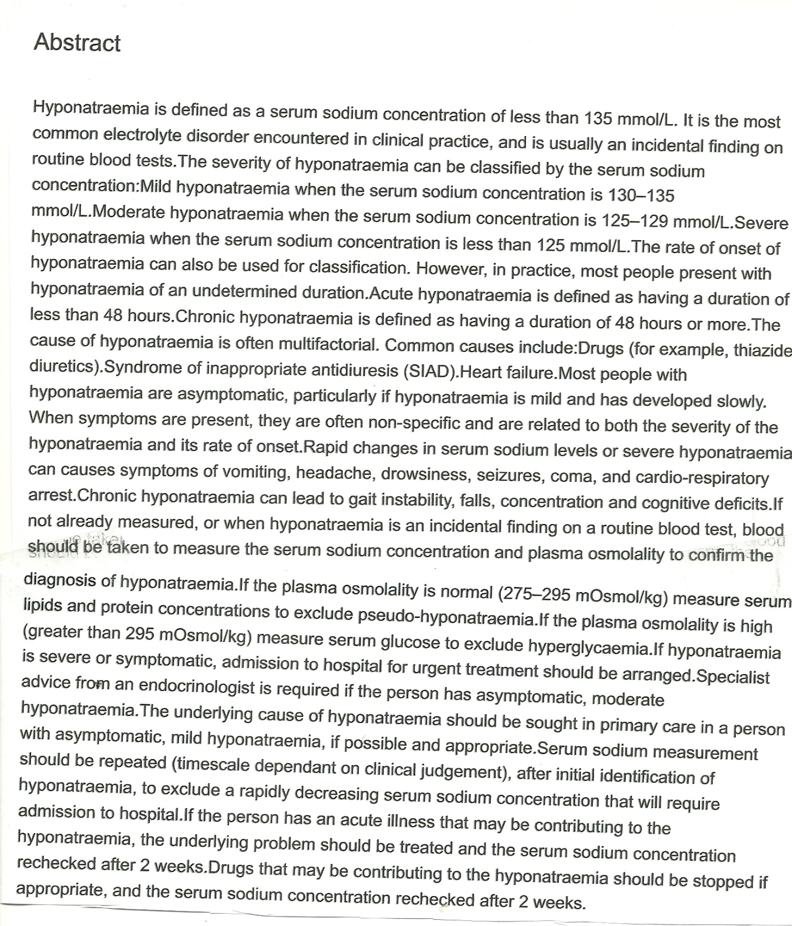
Clinical Knowledge
Summary from NICE on
Hyponatraemia
Published in April 2015
https://cks.nice.org.uk/hyponatraemia

Slide 56
Recommendations from the audit
There are many causes of hyponatraemia and in many cases, the cause is obvious.
However, where the cause is uncertain, a number of additional biochemical investigations may help to determine this and a failure to do so may result in the patient undergoing unnecessary procedures, receive inappropriate treatment and even prolong their stay in hospital.
Such tests include a random urine sodium, paired urine and serum osmolality, thyroid function tests and a 9am cortisol.
Reflex testing for lipids and proteins is recommended in order to exclude pseudohyponatraemia.
Trusts should have a guideline available for the investigation and management of hyponatraemia and biochemists have a contribution to make in working with their clinical colleagues on the laboratory investigation of hyponatraemia and this should possibly include a section on the diagnosis of SIADH.
Algorithms are available to assist in which biochemical tests are useful according to the volume status of the patient.

Slide 57
Acknowledgements
Annette Thomas and the ACB National Audit Committee for giving me the opportunity to carry out the audit and a special thanks to the following for their useful comments on the draft:
Dr Bill Simpson
Jamie West
Sarah Robinson
Gareth McKeeman
Dr Charles Van Heyningen
Ashley Shalloe of the ACB Office for distribution of the survey monkey and for data collection
To those laboratories who kindly responded to the survey monkey

