Slide 1
NW regional audit of CA125 requesting in primary care

Slide 2
NW Audit meeting format
Start of collaborative NW regional audit
Using RCPath template

Slide 3
http://www.rcpath.org/clinical-effectiveness/clinical-audit/clinical-audit-templates/clinical-biochemistry-audit-templates.htm

Slide 4
Ovarian Cancer
2% lifetime risk for women in England and Wales
Poor survival rate - advanced stage at presentation
April 2011, NICE published guidelines on Ovarian Cancer, the recognition and initial management (CG122)
Analysis of CA125 in primary care patients with symptoms suggestive of ovarian cancer
Aid detection at an earlier stage of disease
Aiming to improve outcomes for patients.

Slide 5
Audit aims
To determine:
Whether CA125 is being requested in women with symptoms suggestive of ovarian cancer
If ultrasound is being carried out in appropriate cases
Changes in the above parameters in the two years after NICE

Slide 6
Methods
Data for CA125 requests in a one month period (March 2012), was extracted from the laboratory system and analysed in Excel
Electronic patient notes were used to extract further clinical information and imaging
The audit was repeated one year later ( March 2013)
Only the first request from any patients with multiple requests was included
This audit was carried out at six Trusts across the North West (NW) ACB region
Mid Cheshire, Lancashire Teaching, Royal Blackburn, Trafford, Royal Bolton and Aintree Hospitals

Slide 7
Appropriateness of clinical details
Rate of test appropriateness is consist across the NW region
Mean of 66% of requests (54-72% range)
Consistent across 2012 and 2013
Pie chart shows clinical details classed as
Appropriate from 2012

Slide 8
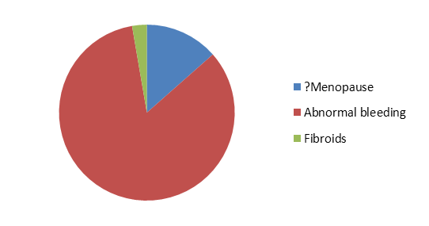
Inappropriate symptoms
Abnormal bleeding
Notes:
Shows the clinical details of primary care requests for CA125 classified as inappropriate according to NICE guidance (2012)

Slide 9
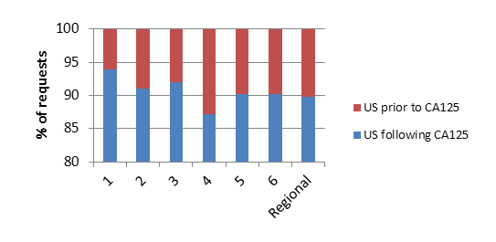
Temporal pattern of US & CA125 requests

Slide 10
Patients with raised CA125
Raised CA125 | 2012 | 2013
No ultrasound | 17 % | 23 %
No imaging of any kind | 2.4 % | 9.8 %

Slide 11
Patients with raised CA125
5 % total requests in 2013 – Raised CA125
63 % had abnormal ultrasound features
13 % Ovarian cancer
Data was consistent across both years
Unknown
cause
Fibroids/
cysts
Notes:
2013 data n = 31 patients

Slide 12
Patients without raised CA125
CA125 not raised | 2012 | 2013
Ultrasound | 46 % | 41 %
Abnormal features on ultrasound | 30 % | 30 %
Notes:
Ultrasound scans are also being carried out in patients without a raised CA125, 46% of patients in 2012 compared with 41% in 2013. Abnormal ultrasound features were found in 30% of this patient group in both 2012 and 2013.

Slide 13
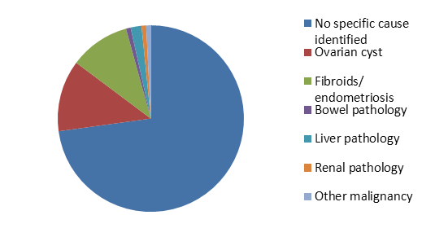
Patients without raised CA125 but abnormal ultrasound
Fibroids
Cyst
Unknown cause
No ovarian cancer
Notes:
2013 n= 305

Slide 14
Summary
Across the NW region, 66% primary care requests for CA125 are appropriate
If abnormal bleeding were regarded as an appropriate symptom compliance with this standard would be improved
Several studies in a systematic review refer to abnormal bleeding as an ovarian cancer symptom
83% of patients with raised CA125 had ultrasound in 2012, this fell to 77% in 2013
This may reflect clinicians loosing confidence that a raised CA125 always requires investigation

Slide 15
References
NICE Clinical Guidance CG122 - Ovarian cancer, The recognition and initial management of ovarian cancer. http://guidance.nice.org.uk/cg122
British Journal of Obstetrics and Gynaecology (2005): Symptoms associated with diagnosis of ovarian cancer: a systematic review. 112: 857-865.

Slide 16
Acknowledgements
Lance Sandle
Natalie Hunt
Rebecca Allcock
Mandy Pickersgill
Anthony Beardsmore
Andrew Hutchesson
Emily Stratta
Carrie Chadwick
Sally Hanton
Sarah Robinson

