Slide 1
Serum Creatinine and eGFR
Where Are We Now?
Dr Mike Bosomworth
Lead Clinician - Blood Sciences
Leeds Teaching Hospitals
16th April 2013

Slide 2
Why measure serum creatinine?

Slide 3
RENAL CLEARANCE
Substance cleared by renal excretion clearance (Cy ):-
Cy = UyV
Py
(V = Urine flow rate)
Substance freely filtered and excreted by glomerular filtration (i.e. not
secreted) renal excretion determined by GFR and plasma
concentration:-
UyV = GFR x Py then GFR = UyV = Cy
Py

Slide 4
Does Creatinine Clearance = Glomerular Filtration Rate?
Is creatinine excreted by glomerular filtration alone (renal clearance = GFR)?
Is creatinine filtered and secreted (renal clearance exceeds GFR)?
Is creatinine filtered and reabsorbed (renal clearance less than GFR)

Slide 5
Equations for GFR Calculation
Recommended equation ID-MS traceable abbrMDRD (Scr in umol/l)
eGFR = 175 x (((Scr – intercept)/slope)x 0.011312)^{-1.154} x Age^{-0.203} x (0.742 if female) x (1.21 if African )
N.B. Most recent Schwartz Formula uses constant of 0.41 (IDMS calibrated enzymatic assay)
CKD-EPI ?

Slide 6
Jaffe Reaction
alkaline pH
Creatinine + picric acid
Orange-red (Janovski)
complex
Read @ 510 nm

Slide 7
Assay Interferences
Jaffe
Bilirubin (negative)
Keto Acids
Glucose and other metabolites
Proteins
Drugs

Slide 8
RENAL CLEARANCE
Substance cleared by renal excretion clearance (Cy ):-
Cy = UyV
Py
(V = Urine flow rate)
Substance freely filtered and excreted by glomerular filtration (i.e. not
secreted) renal excretion determined by GFR and plasma
concentration:-
UyV = GFR x Py then GFR = UyV = Cy
Py

Slide 9
Jaffé Reaction - Modifications
Kinetic
  Interference
    Rapid – e.g. acetoacetate – within 20 secs
    Slow – e.g. protein – 80 – 100 secs
    Measure absorbance change between 20 and 80 secs
Compensated
  Interference
    Protein – adjust calibrator set point to take account of pseudo-creatinine contribution of protein i.e. subtract approx 27 umol/l
Combination of the above

Slide 10

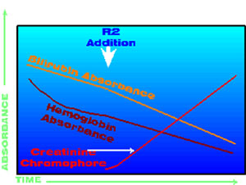

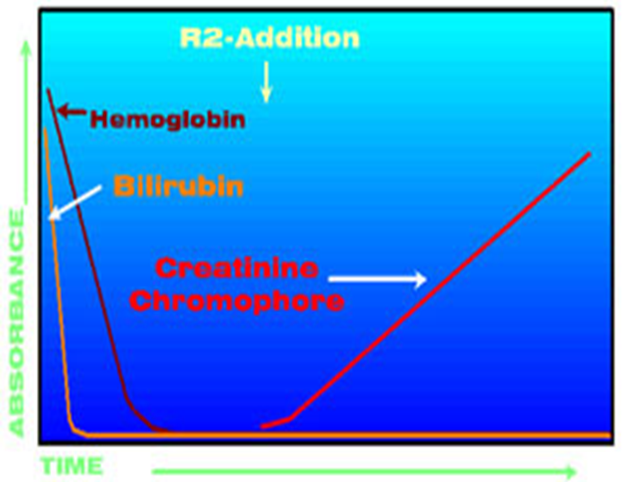
Jaffé Reaction – Modifications
O’Leary + Kinetic

Slide 11
Enzymatic Creatinine
One Method?

Slide 12
Assay Interferences
Jaffe
Bilirubin
Keto Acids
Glucose and other metabolites
Proteins
Drugs
Enzymatic
Drugs (fewer)

Slide 13
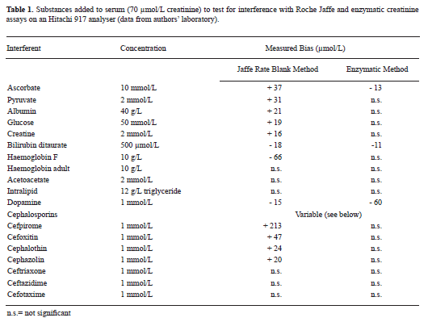

Slide 14
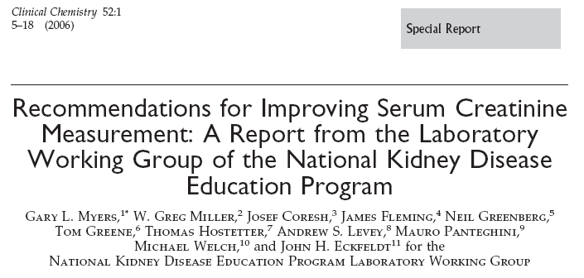
Jaffe M: Ueber den Neiderschlag, welchen Pikrinsaeure on normalen Harn erzeught and ueber eine neue Reaktion des Kretinins
Z.Physiol.Che. 1886;10:391-400

Slide 15
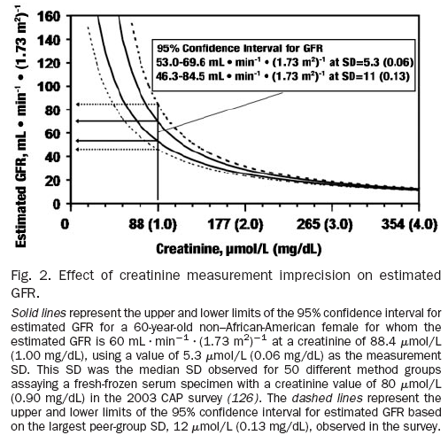
C.V. = 6.0%
C.V. = 12.4%
Clinical Chemistry 52:15–18 (2006)

Slide 16
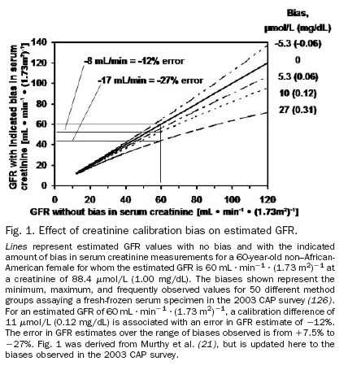
Clinical Chemistry 52:15–18 (2006)

Slide 17
Recommendations for Improving Serum Creatinine
Measurement: A Report from the Laboratory
Working Group of the National Kidney Disease
Education Program – Clin Chem 2006;52:5-18
IVD manufacturers should recalibrate serum creatinine methods to be traceable to IDMS and should coordinate the introduction of recalibrated serum creatinine methods with the introduction of a revised GFR-estimating equation appropriate for use with zero-biased routine method

Slide 18
Certification of Creatinine in a Human Serum
Reference Material by GC-MS and LC-MS
Clin Chem 2007;53:1694-1699
SRM 967 - 66.5 umol/L for serum pool 1 (a value close to the diagnostically important concentration of 88.4 umol/L) and 346.2 umol/L for serum pool 2 (a concentration corresponding to that expected in a patient with chronic kidney disease).

Slide 19
WEQAS Creatinine Scheme
Total no. Participants: 390

Slide 20
Method Bias Relative to Overall Mean (Distributions KG – KM)

Slide 21
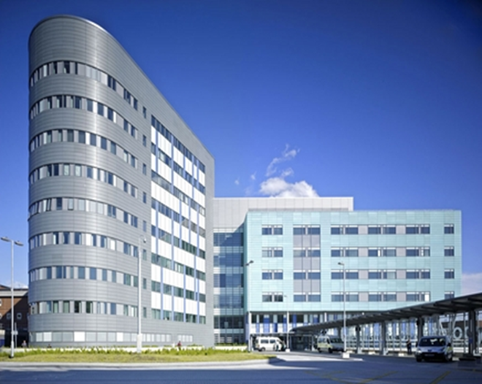
Regional Oncology Unit

Slide 22
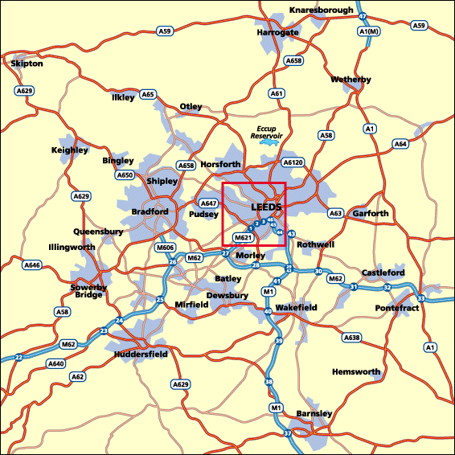
10 miles

Slide 23
Theoretical Differences using NEQAS Slopes and Intercepts (2010)
 |  |  | Female, 45y, 55kg |  | Female, 75y, 60kg
 | UK labs | Creatinine² (μmol/l) | C&G³ (ml/min) | Carboplatin⁴ (mg) | C&G³ (ml/min) | Carboplatin⁴ (mg)
Enzymatic | 5% | 50 | 108.5 | 801 | 81.0 | 636
Kinetic Jaffe - Abbott | 10% | 60 | 90.7 | 694 | 67.7 | 556
Kinetic Jaffe - Bayer | 4% | 64 | 85.1 | 661 | 63.5 | 531
Kinetic Jaffe - Dade Behring | 2% | 58 | 93.7 | 712 | 69.9 | 569
Kinetic Jaffe - Olympus | 12% | 64 | 85.4 | 663 | 63.8 | 533
Kinetic Jaffe - Compensated | 47% | 60 | 90.8 | 695 | 67.8 | 557
O'Leary | 7% | 67 | 81.2 | 637 | 60.6 | 514
Endpoint Jaffe | 2% | 68 | 80.8 | 635 | 60.3 | 512
Standardized Creatinine¹ |  | 50 | 109.2 | 805 | 81.5 | 639
Variability |  | 34% | 34% | 26% | 34% | 24%

Slide 24
6 Jaffé and 3 Enzymatic West Yorks
(10 samples)

Slide 25
Calculated Clearance / GFR vs Measured

Slide 26
Calculated vs Measured
C-G CrCl using min SCr (ml/min) | C-G CrCl using max SCr (ml/min) | Wright eGFR using min Enz SCr (ml/min) | Wright eGFR using max Enz SCr (ml/min) | Wright eGFR using min Jaffe SCr (ml/min) | Wright eGFR using max Jaffe SCr (ml/min) | Min eGFR (ml/min) | Max eGFR (ml/min) | DTPA measured GFR (ml/min)
102.5 | 66.8 | 112.0 | 100.8 | 113.8 | 79.2 | 66.8 | 113.8 | 62.2
182.8 | 137.6 | 167.0 | 155.4 | 163.2 | 128.4 | 128.4 | 182.8 | 128.8
66.3 | 51.3 | 66.1 | 62.8 | 75.2 | 58.2 | 51.3 | 75.2 | 63.5
103.7 | 86.1 | 77.2 | 73.3 | 85.8 | 71.2 | 71.2 | 103.7 | 67.1
52.1 | 43.7 | 62.9 | 58.9 | 63.5 | 53.3 | 43.7 | 63.5 | 48.1
78.7 | 61.7 | 73.4 | 68.6 | 77.7 | 60.9 | 60.9 | 78.7 | 67.5
24.7 | 21.2 | 31.6 | 29.2 | 31.7 | 27.6 | 21.2 | 31.7 | 22.3
34.3 | 30.4 | 44.8 | 43.0 | 45.2 | 40.1 | 30.4 | 45.2 | 28.5
32.1 | 29.6 | 31.1 | 29.7 | 32.6 | 30.1 | 29.6 | 32.6 | 23.3
24.6 | 22.3 | 27.6 | 25.9 | 28.3 | 26.5 | 22.3 | 28.3 | 29.2

Slide 27
Carboplatin Dose Using Calvert
(AUC = 6)

Slide 28
Carboplatin - Complications
Too much
  Bone marrow suppression
    Thrombocytopaenia
      Bleeding
    Leucopaenia
      Neutropaenia
      Infections
    Anaemia
    Dose dependant
    Increased if prior therapy especially if also included cisplatin
Too little
  Decreased response

Slide 29
WEQAS Return (2012)
Method | Overall Mean | 22.8 | 319.8 | 271.8 | 136.3
 | Overall Number | 267 | 290 | 291 | 288
Vitros | Method Mean | 30.4 | 319.6 | 272.9 | 138.4
 | Number | 11 | 11 | 11 | 11
Vitros ID-MS traceable | Method Mean | 30.7 | 319.5 | 273.5 | 139.3
 | Number | 17 | 17 | 16 | 16
Enzymatic | Method Mean | 27.2 | 326.7 | 276.1 | 139.7
 | Number | 53 | 56 | 56 | 54
Kinetic Jaffe | Method Mean | 28.4 | 322.0 | 272.7 | 137.7
 | Number | 49 | 50 | 52 | 51
Jaffe - IDMS | Method Mean | 16.9 | 317.3 | 270.2 | 134.1
 | Number | 124 | 148 | 146 | 146

Slide 30
NEQAS Return (2012)
 | Overall Mean | 74.2 | CV | 8.2
 | Number | 543
Dry Slide (1) | Mean | 71.4 | CV | 2.6
 | Number | 59
Comp. Kin. Jaffé (4) | Mean | 73.7 | CV | 7.2
 | Number | 339
Trad. Kin. Jaffé (1) | Mean | 83.3 | CV | 8.5
 | Number | 60
Enzymatic (2) | Mean | 72.1 | CV | 3.8
 | Number | 134
Lowest | Mean | 67 | CV | 2.8
Highest | Mean | 83.3 | CV | 8.5

Slide 31
Carboplatin Dose (AUC=6)
45 yr old women weighing 65 kg using C&G and Calvert formula
Serum creatinine = 83 umol/L
  Carboplatin dose = 612 mg
Serum creatinine = 67 umol/L
  Carboplatin dose = 726 mg
True change serum creatinine and CrCL = 0
Change in dose = 116 mg = increase 19%

Slide 32
Effect of Change in Serum Creatinine Calibration on Prevalence of Low GFR in Nondiabetics in NHANES III.
(Clase et al. J Am Soc Nephrol 2002;13:2811-2816)
Lab used in Third National Health and Nutrition Examination Survey (NHANES)
Results adjusted to method used in Modification of Diet in Renal Disease Study (MDRD)
(i.e. uncalibrated – 20.3 umol/l)
CKD
1
2
3
4+
CKD
1
2
3
4+

Slide 33
Serum Creatinine and Calculated Creatinine Clearance / Estimated Glomerular Filtration Rate Survey

Slide 34
Assay + Instrument – Lab.
Method | Number | % (100)
Manufacturer’s Jaffe | 3 | 4.8
Man. Kinetic Jaffe | 7 | 11.3
Man. Comp. Kinetic Jaffe | 3 | 4.8
Man. Enzymatic | 10 | 16.1
Man. Jaffe + Enz | 9 | 14.5
Manufacturer only | 17 | 27.4
Jaffe | 2 | 3.2
Kinetic Jaffe | 3 | 4.8
Compensated Jaffe | 1 | 1.6
Enzymatic | 5 | 8.1
Jaffe + Enz | 1 | 1.6
YES! | 1 | 1.6
Total | 62 | 100
IDMS Traceable | 57 | 91.9

Slide 35
Assay + Instrument - POCT
Analyser | Number | Method
Roche | 1 | ?
Nova | 3 | StatSensor
Abaxix Piccolo | 1 | Enzymatic
Total | 5
N/A | 36
Total Respondents | 41
No response | 21
IDMS Traceable | 2 Yes 5 No = 7!

Slide 36
Serum Creatinine and Calculated Creatinine Clearance / Estimated Glomerular Filtration Rate Survey

Slide 37
Adjustment Factors
Adjustment Factors | Number
-26.5 umol/L | 1
-26 umol/L | 3
-11 umol/L | 1
Adjust if bilirubin high | 1
Total | 6
Yes | 8!
No | 50
No response | 4

Slide 38
Serum Creatinine and Calculated Creatinine Clearance / Estimated Glomerular Filtration Rate Survey

Slide 39
cCrCl and / or eGFR
11 labs calculated a creatinine clearance using serum and urine creatinine.
No adjustment for height and weight
Question was really looking to see if anyone was using C&G etc
eGFR Formula | Number
MDRD | 19
175 with slope and intercept | 17
175 no slope and intercept | 4
186 | 2
Not stated | 8
Total | 50
One lab didn’t know whether they were using a slope and intercept (they were) and they were reporting eGFR to non-patients only

Slide 40
Serum Creatinine and Calculated Creatinine Clearance / Estimated Glomerular Filtration Rate Survey

Slide 41
Profession | Formula | Number
Oncologists | MDRD | 2
Oncologists | C&G | 4
Oncologists | Wright (no CK) | 1
Oncologists | Measured CrCl | 1
Oncologist | NK | 1
Pharmacist | MDRD | 1
Pharmacist | C&G | 8
Pharmacist | Schwartz | 1
Paed Transplant | Schwartz | 1
Haematology | C&G | 1
Renal | MDRD | 1
Diabetes | NK | 1
Radiology | NK | 1
DVT Service | MDRD | 1
Not Known | Not Known | 21
Total |  | 46
Respondents |  | 36/62

Slide 42
Role of the Clinical Biochemist
Consultants in Clinical Biochemistry: The future – RCPATH/ACB 2009
4.3.4 Promoting the contribution of laboratory medicine
Clinical biochemists in the UK are leading the way in promoting the contribution of laboratory medicine to healthcare.
4.3.5 Optimising knowledge management
Recommendation: Consultants in charge of NHS clinical biochemistry departments should recognise the growing importance of knowledge management and take responsibility for ensuring implementation in a coordinated manner.
ACB statement on laboratory assessment of kidney function –Nov. 2010
Clinical users should be made aware that significant changes in estimated glomerular filtration rate might occur when a change in serum creatinine method is made. Examples of users likely to require well documented notification include renal physicians, oncologists, pharmacists, paediatricians and general practitioners

Slide 43
Healthcare Professionals Using SCr to Calculate CrCl and / or GFR and the Formula Used
Survey | Number / Percent
Respondents | 36
Don’t know | 21
Non respondents | 26
Don’t know | 47
Don’t know | 76%
Do know | 24%

Slide 44
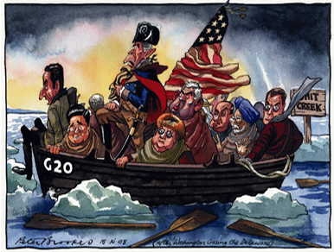
Serum Creatinine and eGFR
Where Are We Now?

Slide 45
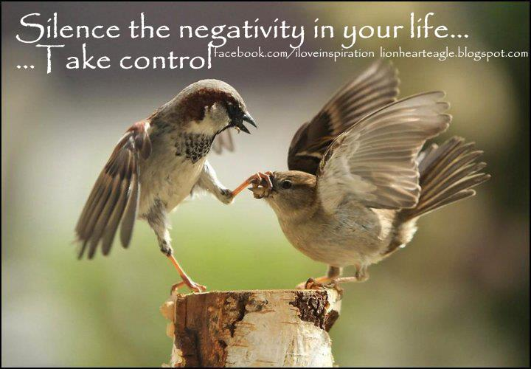
We need to be out there for the good of our profession, but much more importantly, to ensure optimum patient outcomes

