Slide 1
FSH requesting and NG 23
Audit of Demand Management Strategies in York

Slide 2
Introduction
NICE Guideline 23 on Menopause: Diagnosis and Management was published in 2015
Clear recommendations were made about when to use FSH to assist in diagnosis of menopause.
FSH should not be used in patients >45 years
FSH should not be used in patient on high dose progesterone or combined oestrogen and progesterone contraception
Elevated FSH on two samples 4-6 weeks apart in patients <40yrs may be suggestive of premature ovarian failure
Stopping the use of FSH hormone testing in patients >45yrs was recognised as a challenge in implementing the guidelines
It was also recognised as a potential cost saving
NICE made some recommendations for what labs and CCG should do

Slide 3
The NICE recommendations included:
GP education: GP/Laboratory liaison group, newsletter
Electronic requesting prompt to discourage requesting
Refer GPs to NICE Clinical Knowledge Summary on Menopause
Costing template to estimate savings that can be made
Clinical audit to monitor and improve

Slide 4
NICE Clinical Knowledge Summary

Slide 5
Local audit project in York
3 months of FSH requests were extracted from the LIMS system
Assessed against criteria derived from the NICE guideline
Changes implemented:
(GP education leaflet, comments on reports, ICE requesting prompt)
Re-audit at 6 months and 12 months post change:
Has there been an improvement
Is it continuous and/or sustained
Are further changes/developments required

Slide 6
Baseline data – summary of 3 months FSH requests
Patient age | Number of requests | Percentage
<45yrs | 1092 | 57%
>45yrs | 815 | 43%
50 (5%) of FSH requests in patients >45yrs mentioned contraceptive use
8/18 (44%) women with results suggestive of POF had FSH repeat
22%
25%
17%
36%

Slide 7
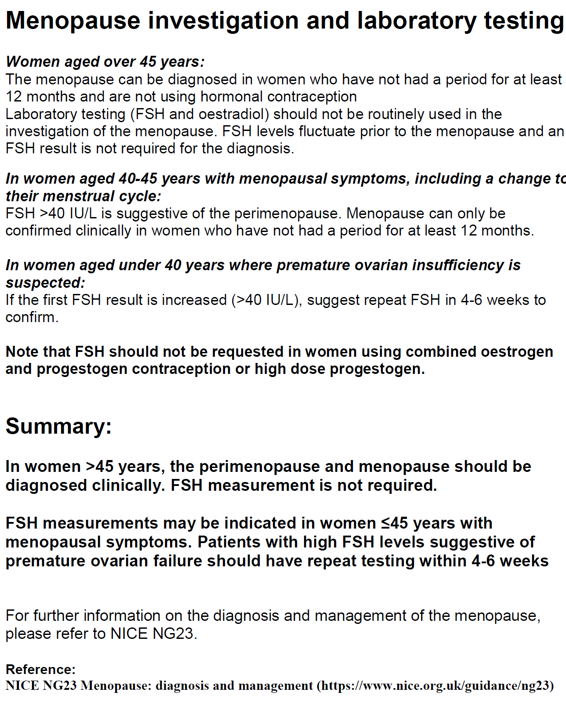
GP information sheet
GP information leaflet was produced
Re-stated the NICE guidelines but with a focus on FSH.
Added to Laboratory Medicine website
Passed to local CCG communication team to distribute

Slide 8
Interpretative coded comment on reports
New coded interpretative comments were created for reports.
Added automatically to all FSH results in patients over the age of 45yrs “Women aged >45yrs should not have FSH requested to diagnose menopause, NICE guideline NG23”
Added by Duty Biochemist when appropriate during clinical authorisation
“FSH measurement should not be used to diagnose menopause in patients on hormone contraception, NICE guideline NG23”
“Results may suggest premature ovarian failure consider repeat in 4-6 weeks to confirm”

Slide 9
Electronic requesting prompt in ICE Order Comms
Locally we use ICE for GP order comms requesting
Rule in ICE can be very simple or complicated……..
Converting tests to a “picklist” relating to reason for order is possible
We went for the simplest option of a “Help” rule
This was just a “pop-up” box that appeared every time an order for FSH was place which stated:
“Please note FSH testing is not recommended in patients >45yrs to diagnose menopause (See NICE Guideline NG23)”

Slide 10
Re-audit data at 6 months and 12 months
Requests in patients <45yrs have fallen slightly (1092 to 921)
Requests in patients >45yrs fell initially
(815 to 539)
Then stabilised at 12 months post change
(491 – 35% of total FSH)
6/9 (67%) women with results suggestive of POF had FSH repeat (12 months post)
50 (11%) of requests in patients >45yrs mentioned contraceptive (12 months post)

Slide 11
Conclusions
A combination of education (coded comments, GP leaflet) and electronic requesting prompts can lead to more appropriate FSH testing
However this benefit was not ongoing – plateau effect! Demand optimisation becoming more important (Aligned Incentive Contracts)
Are all GPs convinced by the guidelines?
Reassurance (false) of having FSH results in patients >45yrs?
Continuous improvement to the processes and sustained educational efforts may be required in order to see further benefit
Do we now need to take a targeted approach aimed at certain GPs and GP surgeries?

Slide 12
Next steps……
Make a new version of the GP information sheet
(Improve clarity and highlight the main messages)
Re-work the electronic prompt on ICE to improve/refine
(see next slide)
Things we haven’t done yet:
Cost implications (£6.40 per test x 328 x 4 = ~£8500 saving in 1 year). Potential for further savings of similar magnitude?
Hyperlink to NICE Clinical Knowledge Summary (on ICE, on reports)
GP/Pathology user group. We haven’t got one and are jealous of others who have this kind of forum!

Slide 13
Second version of GP information sheet
We are now adding a hyperlink to the Laboratory Medicine website to FSH results in patients over the age of 45yrs
May try to target this leaflet at certain GPs or GP surgeries in future…….

Slide 14
Updated ICE prompt – more selective
Now using a “Question” rule in ICE which only triggers when a request for FSH is made in a female patient >45yrs old.
The question asks: “Is this a request to aid in diagnosis of menopause in a patient >45yrs old?”
If they say “Yes” – the request is cancelled and they get the following message:
“Test not required see NICE Guideline NG23”
If they say “No” the request proceeds……

Slide 16
Latest data……
3 months immediately after last round of changes
843 requests in patients <45yrs (67%)
403 requests in patients >45yrs (32%)
This represents a further (very slight) fall in FSH requests in patients >45years.
Still plenty of room for improvement……..

Slide 17
The End
Contact details:
Daniel Turnock (daniel.turnock@york.nhs.uk)
01904 721847 / 01904 726366

