Slide 1
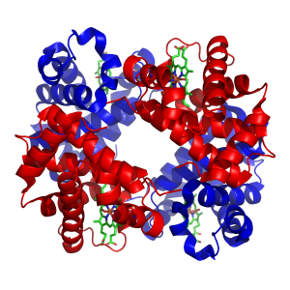
The use of HbA1c in the diagnosis of Type 2 Diabetes Mellitus: A National Audit of practice

Slide 2
How did the audit come about?
Discussion around practice at the NCBAG
Sarah mentioned thinking about auditing it within her Trust………
! Let’s do a national audit
Sarah should do it
Sarah phoned a few friends……
85 responses to the survey were received

Slide 3
Thankfully all respondents were aware of the WHO report from 2011

Slide 4
WHO report summary
HbA1c can be used as a diagnostic test for diabetes provided that:
Stringent quality assurance tests are in place
Assays are standardised and aligned to international reference values
No conditions are present that preclude its accurate measurement.
An HbA1c of ≥48mmol/mol (6.5%) is the cut point for diagnosing diabetes

Slide 5
Is HbA1c is being used for diagnosis of Type 2 Diabetes Mellitus amongst users of your service?

Slide 6
Do you promote the use of HbA1c for the diagnosis of Diabetes Mellitus?

Slide 7
Engagement with users about the use of HbA1c in diagnosis of Diabetes Mellitus

Slide 8
Which groups have been involved in agreeing the content of presentations/publications?
8 respondents gave no answer
4 respondents only involved the laboratory staff
Nobody involved the patients!

Slide 9
Which of the following situations have you highlighted to users as inappropriate to use HbA1c for diagnosis?
Hypopituitarism was added
as a red herring to assess whether
respondents were merely ticking all
boxes.
% respondents

Slide 10
Identification of variants
Identification of variants
Method | Number of laboratories | Does the method identify variants? |  | Does the method identify variant type?
 |  | Yes | No | Yes | No | Unknown
Affinity Primus | 3 | 2 |  | 1 | - | -
HPLC 8160 | 8 | 8 | 0 |  | 5 | 1
Electrophoresis – Capillarys 2 | 3 | 3 | 0 |  | 2 | -
HPLC D10 | 1 | 0 | 1 | - | - | -
HPLC G8 | 31 | 30 |  | 17 |  | 1
HPLC Variant II/Turbo | 10 | 9 |  |  | 6 | -
HPLC G7 | 7 | 6 |  | 5 |  | -
Affinity Hb-9210 | 9 |  | 8 |  |  | -
HPLC HA8180 | 5 | 4 |  | 2 |  | 1
Other | 4 | - | - | - | - | -
No answer | 10 | - | - | 1 | - | -
1
2
1
1
6
1
3
1
1
1
1
1
1
1

Slide 11
Dealing with variants
37 respondents would not report an HbA1c if a variant was detected
The following action is taken:
Number of responses

Slide 12
Other actions for dealing with variants
Number of responses

Slide 13
Question 17 asked for running CVs for glucose and HbA1c methods
Guidelines and Recommendations for Laboratory Analysis in the Diagnosis and Management of Diabetes Mellitus. David B. Sacks, David E. Bruns, David E. Goldstein, Noel K. Maclaren, Jay M. McDonald and Marian Parrott Clinical Chemistry 48:3 436–472 (2002)
The intra-laboratory CV for plasma glucose should be < 2.2%
The intra-laboratory CV for glycated HbA1c should be < 2%

Slide 14
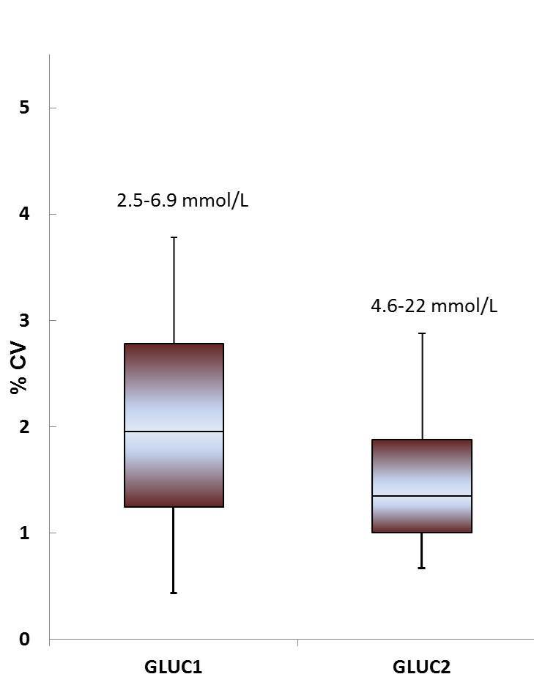
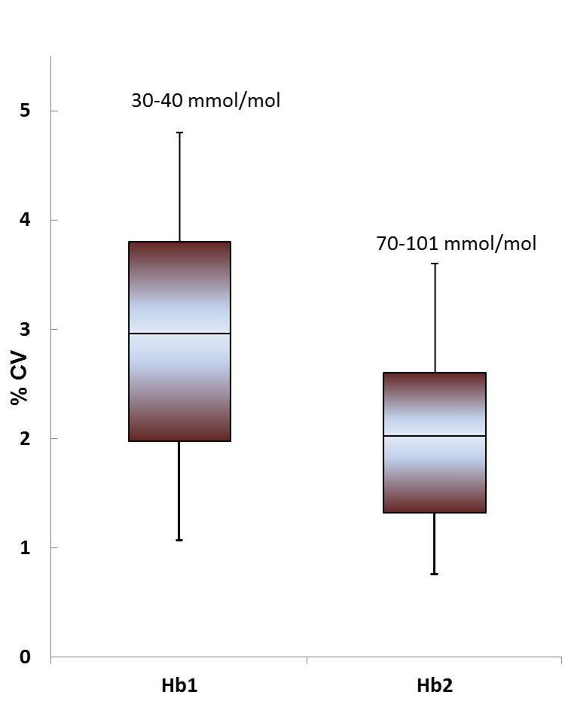
Running CVs for glucose and HbA1c IQC
Glucose
HbA1c

Slide 17
Do you have a mechanism to distinguish between HbA1c for diagnosis and HbA1c for monitoring of diabetes?
65% of respondents are not able to distinguish
Those that could used the following:
Mechanism | Number
Clinical details | 13
Known Type 2 Diabetes patients flagged in system | 2
Manually distinguished at reporting | 11
Separate request codes | 10
Other | 4

Slide 18
Dealing with HbA1c Results

Slide 19
HbA1c reference ranges
56% quote 20-41 mmol/mol
15% quote <42 mmol/mol
7% quote <48 mmol/mol
The remainder all have their own view!
e.g. <53, 27-47, 30-42 mmol/mol

Slide 20
Dealing with HbA1c Results

Slide 21
Interpretative comments
≥48 mmol/mol:
Mostly mention diagnostic cut-off, need for symptoms or repeat sample
21% do not mention diagnostic use of HbA1c
42-47 mmol/mol:
58% indicate patient has increased risk of developing diabetes
<42 mmol/mol:
57% state result is not consistent with diabetes, most also specify patient may be at risk of developing diabetes
Several labs use a standard comment for all HbA1c results regardless of value

Slide 22
Demand Management
30% have a demand management system for HbA1c in place
This is either achieved at requesting, booking in or requests being referred to a manual vetting queue
Response | No. of responses | Notes
28 days | 1
30 days/1 month | 2
56 days | 4 | 1 will reinstate if sample is diagnostic
6 weeks | 2
60 days/2 months | 8 | 3 check whether sample is diagnostic
72 days | 1

Slide 23
Do you or your users continue to carry out glucose tolerance tests?

Slide 24
If GTTs are only being carried out in certain patient groups, please indicate which ones

Slide 25
GTTs in other patient groups

Slide 26
Total number of HbA1c analyses per 100,000 GP population

Slide 27
Total Number of GTT requests per 100,000 GP population

Slide 28
Key Findings
HbA1c is widely used for diagnosis, but this is not being guided
Engagement with users, including patients, could be improved
Caveats of using HbA1c are highlighted but inconsistent
Not all laboratories are aware of their method characteristics
CVs for HbA1c are not meeting recommendations
There is variability around commenting
There remains a mixture of glucose and HbA1c measurements, which aren’t always under the control of the laboratory

Slide 29
Recommendations
Follow the WHO guidance
Engage with users
Highlight caveats
Know your method
Review comments
Highlight differences between GTT and HbA1c

Slide 30
Acknowledgements
National Clinical Biochemistry Audit Group
Team North West:
Shirley Bowles
Sally Hanton
Andrew Hutchesson
Mandy Pickersgill
Tony Tetlow
Advisors:
Garry John and Emma English
David Oleesky
Adrian Heald
Tom Hutchinson
All survey respondents

